Slide 1
Ocean Energy
The Waves of the Future
Presentation October 2019

Slide 2
Basic principle for the concept of using a point absorber

Slide 3
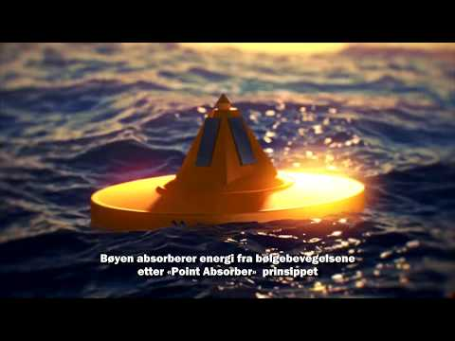

Slide 4
Direct connection to local grid

Slide 6
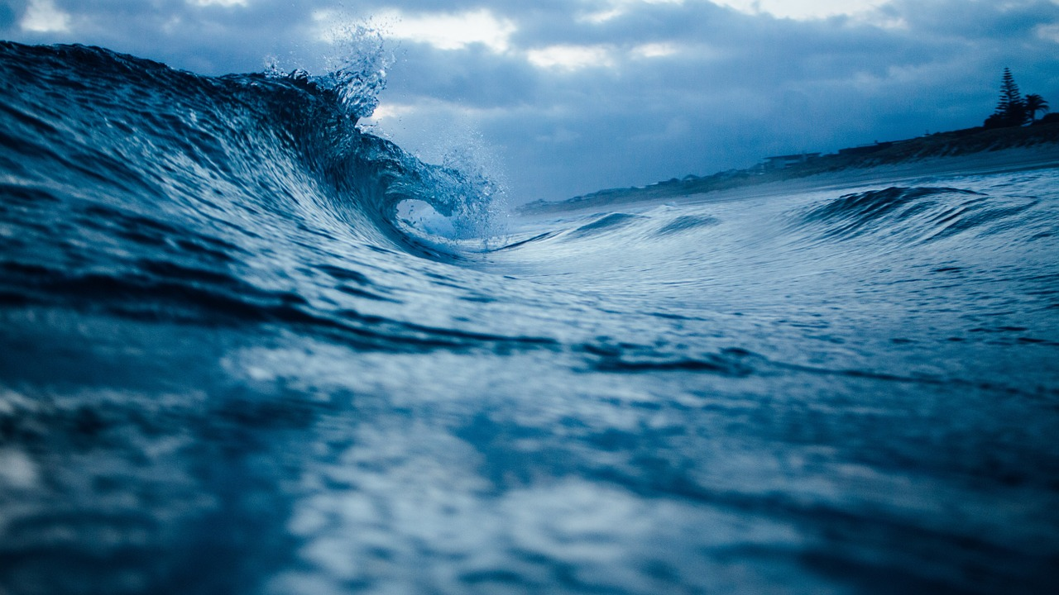
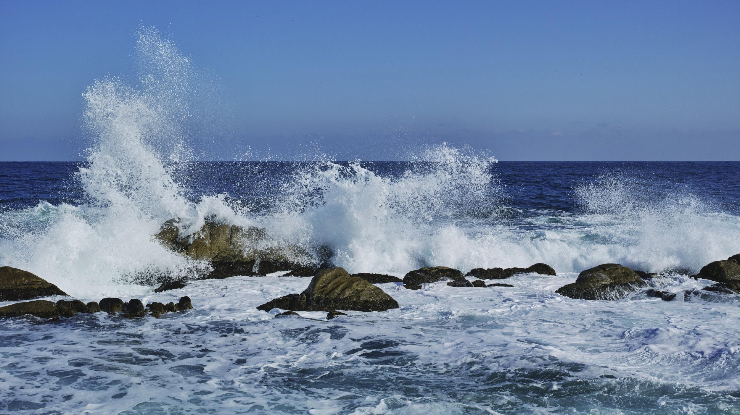
Wave Power – a long story
Accepted fact: There is a lot of energy in the waves
Several technical trials to convert to electricity
Rough weather the major problem
No technical solution yet solved the problem before Ocean Energy’s patented ”Storm Buoy”
Opportunity for big market

Slide 7
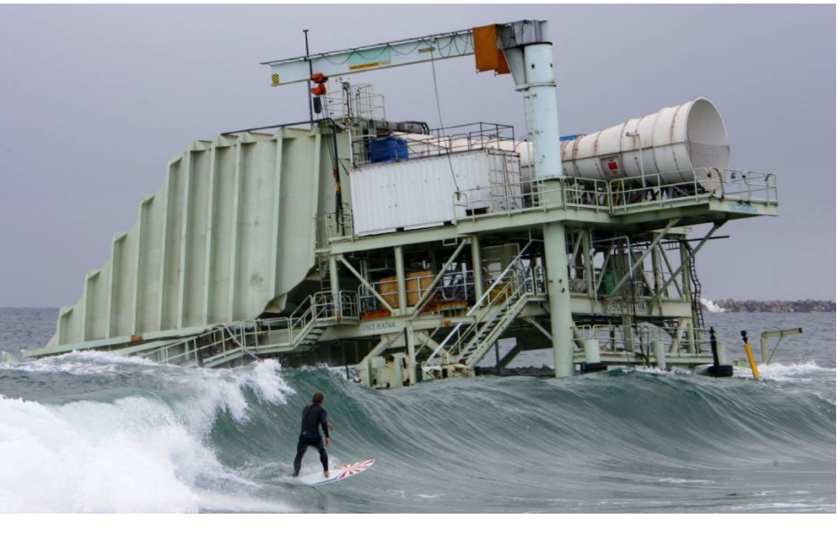
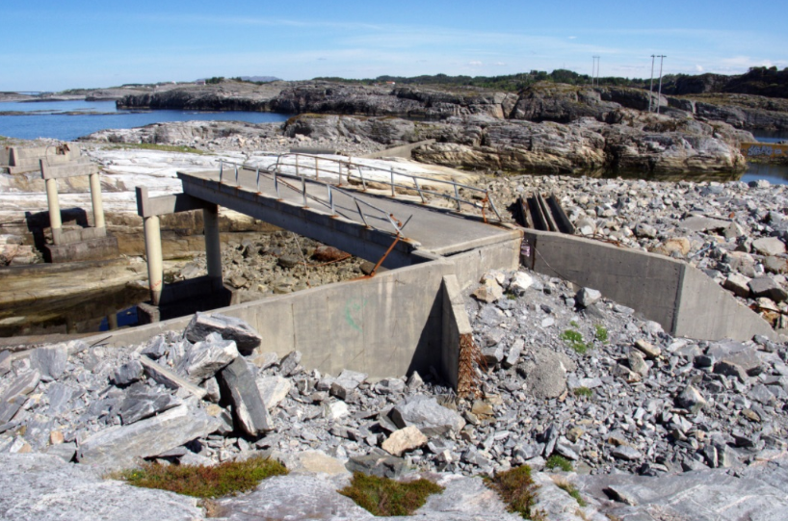
Examples - Results of rough weather
Notes:
Vänstra:
Ocean LinX – 2007.
Oceanlinx is a company created in 1997, specialised in renewable energy and especially in ocean energy conversion. Originally named Energetech, it will be renamed Oceanlinx in 2007. The main technology is based on Wave Energy Converter "WEC" which is a device that uses wave energy and converts it into electrical energy. The WEC operating principle are numerous but Oceanlinx technology focuses on the oscillating water column principle. Oceanlinx company was created in Australia and the technology has been developed over the past twenty years. In 2014, Oceanlinx entered receivership before its technology, intellectual property, brand and trademark were sold to Wave Power Renewables Limited in Hong Kong. Since then, Wave Power Renewables Limited as been developping the technology
Högra:
Norwave. Mitten av 80-talet.

Slide 8
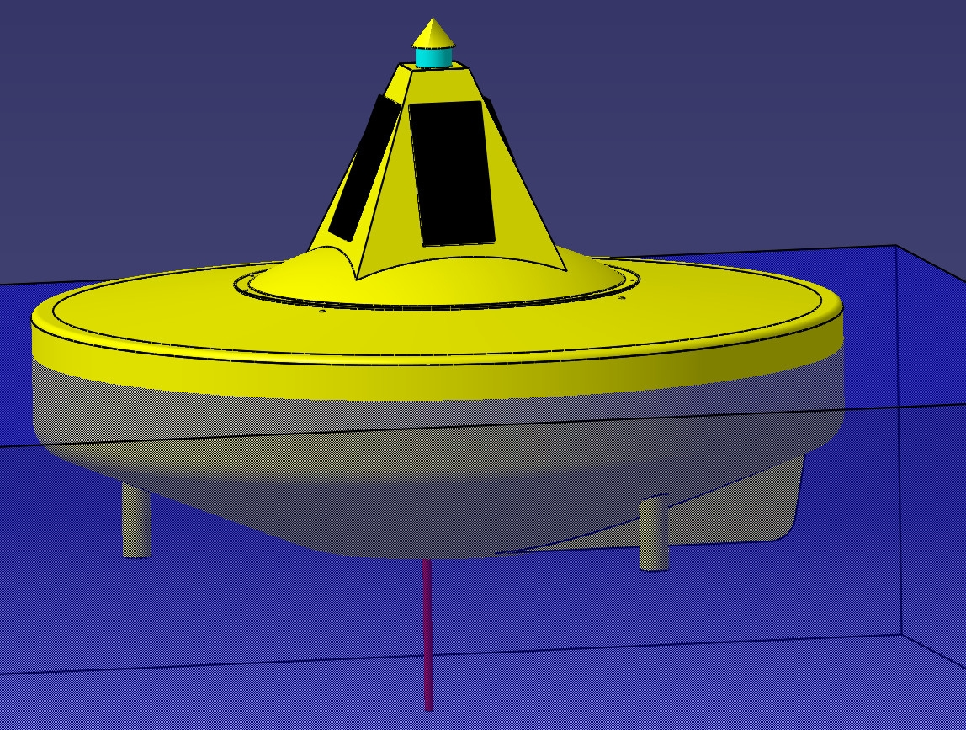
Storm Buoy automatically lowers at extreme weather, regulates for tides and adjusts the ballast tank for optimal resonance with wave amplitudes.

Slide 9
Business idea
OCE shall provide the international market with competitive solutions for wave energy production. The solutions shall be capable to handle extreme rough weather conditions and will contribute to long term energy production from a renewable and environmental friendly source.

Slide 10
Normal production time per. year:
Waves: 4000 – 6000 hours Wind: 2000 – 3000 hours Sun: 1000 – 2000 hours
In the Nordic region, full-power solar energy is often produced less than 1000 hours a year.

Slide 11
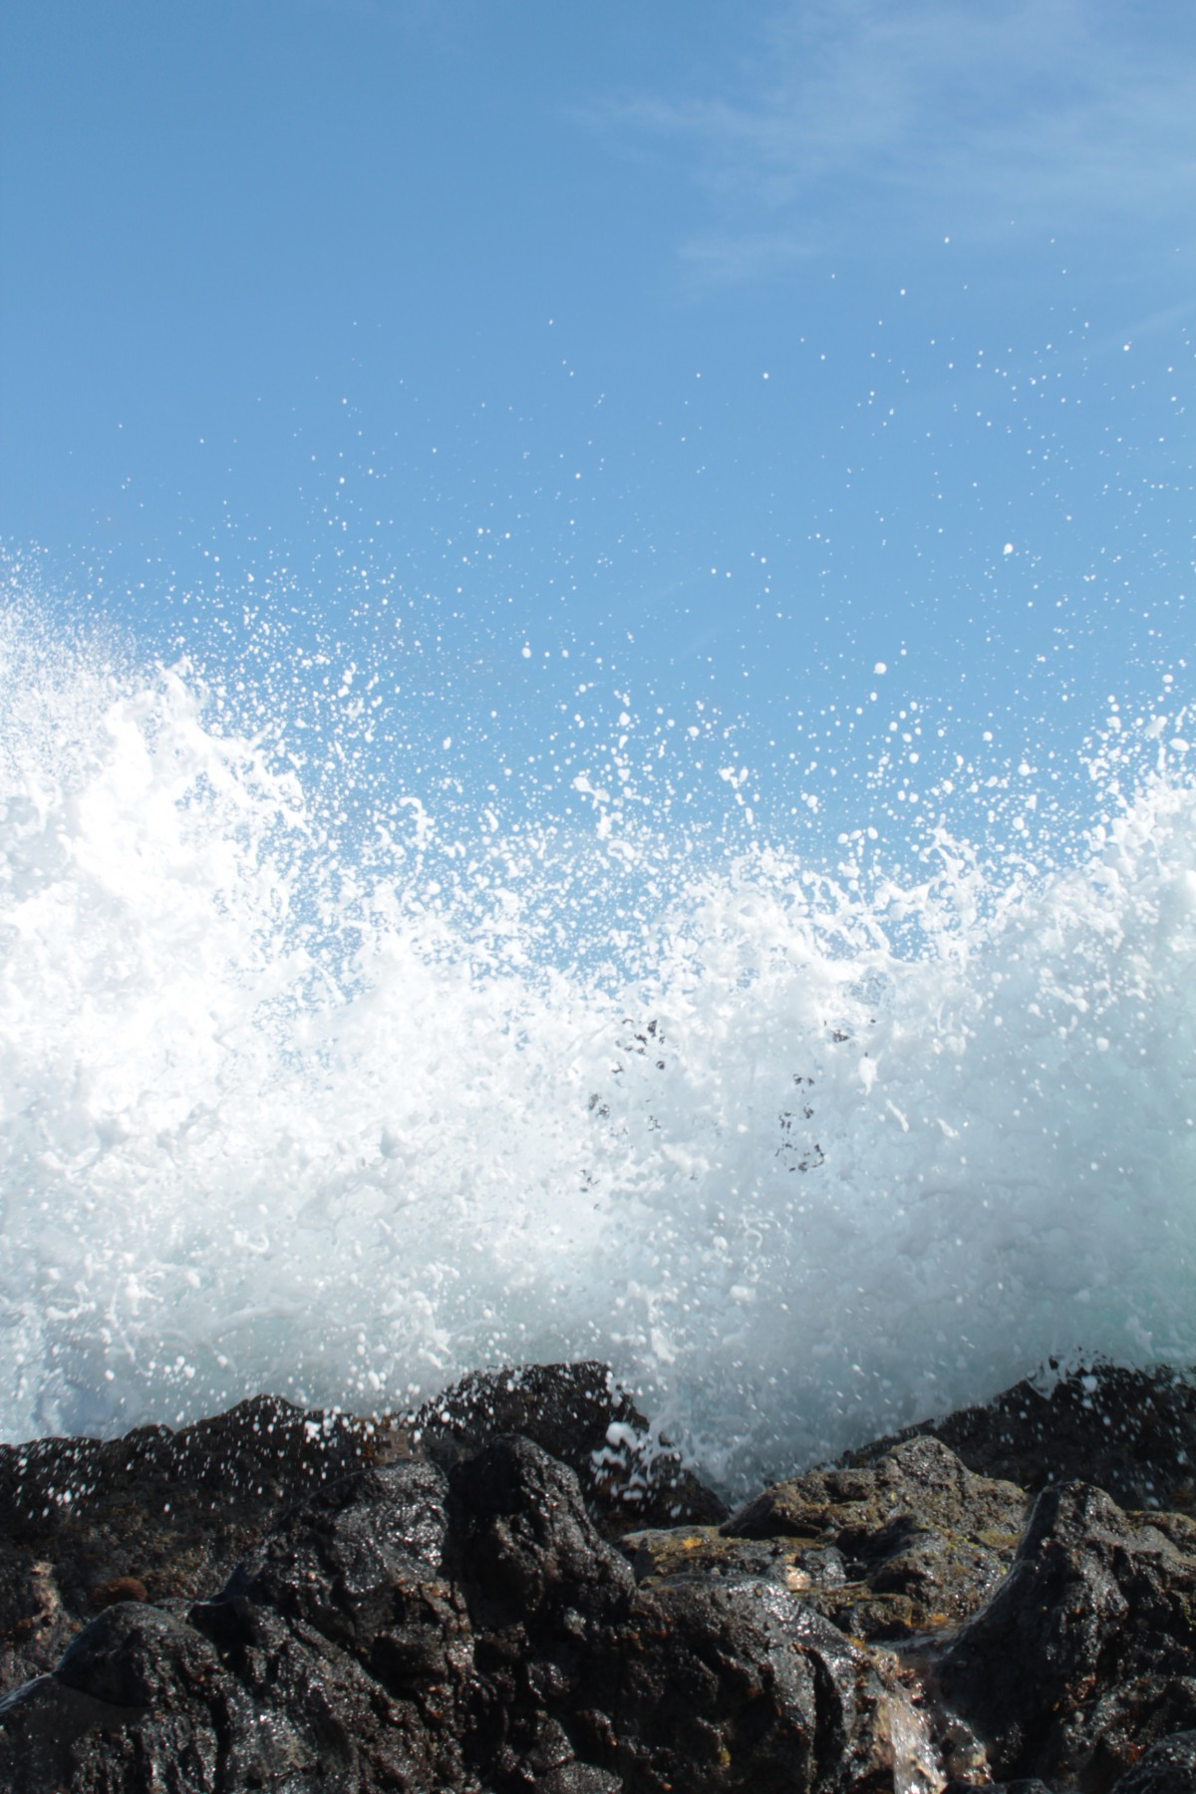
Solution provided by OCE
Integrated system consisting of:
Patented intelligent buoy capable of handling rough weather and various wave conditions by submerging under storms and design the size of the buoy based on local wave climate.
Generator capable of handling a wide range of wave amplitudes resulting in optimal energy production efficiency

Slide 12
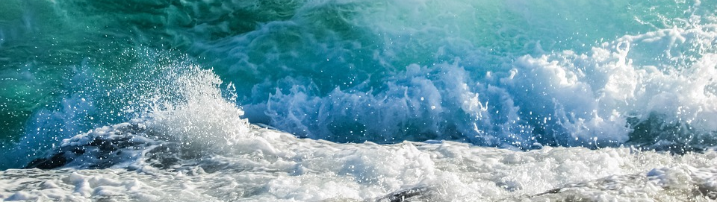
Component for better control of green energy production
Control and planning of green energy production based on e.g. wind and sun has limitations
Wave energy fills parts of the ”gaps” in the green energy production and has a higher degree of predictability
Wave energy is another step to establish a 24/7 green energy production system
The need for production based on fossile to ”fill the gaps” will be reduced

Slide 13
Market
Areas where price of electricity is higher than approx 0,2 €
Areas where electricity production is heavily based on fossile fuel
Areas with attractive wave climate
Areas with focus on ”green” electricity production where there is an ambition to reduce the use of fossile fuel
Islands round the globe will be prime market focus. We have identified at least 500 potental islands of interest.

Slide 14
Potential customers
Typical potential customers for OCE consists of:
Energy companies providing electricity to local communities
Energy companies with a ”green profile”
Companies and other organisations operating at sea with an interest in producing electricity without grid connection or burning fossile fuel. E.g for production of fresh water and loading of batteries for general purposes.

Slide 15
Partner strategy
Partner strategy:
Contribute during development phase
Take part in technical development and application for third party funding
Potential customer for commercial delivery
Ongoing discussions with potential norwegian and international partners

Slide 16
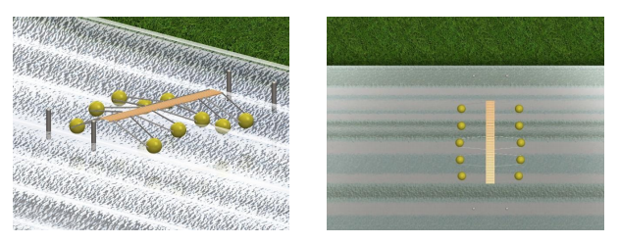
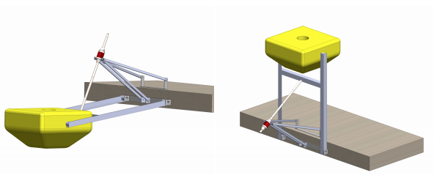
Product overview
Small scale system for installations attached e.g. to floating docks.
Energy production 1 – 10 kW per unit.
For applications with limited power requirements, e.g. free-floating fish farms.
«Svalbard Class Buoy»

Slide 17
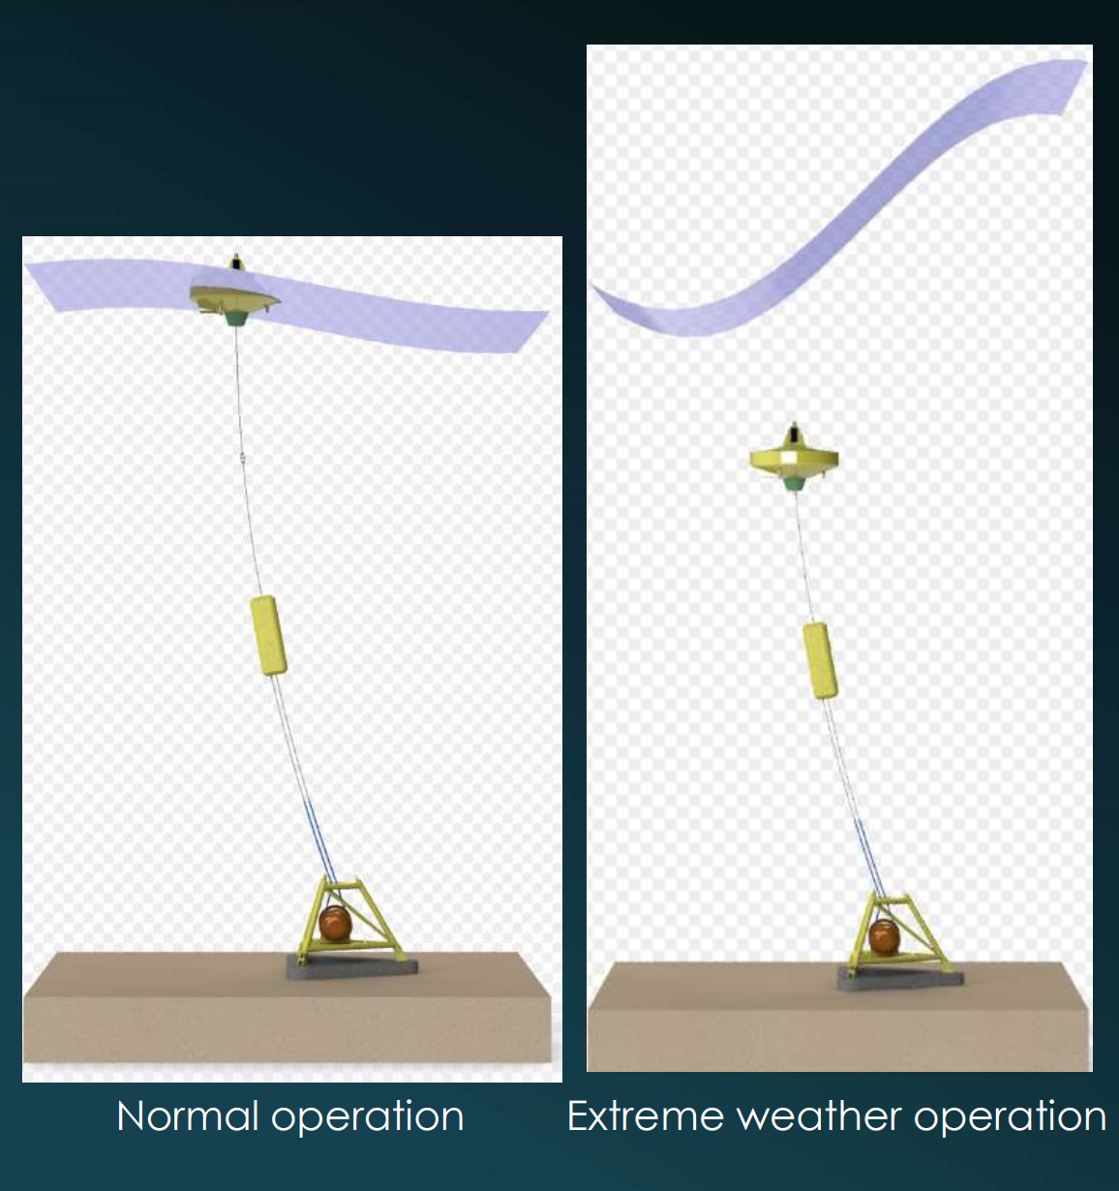
Product overview
Large scale system for installation in open waters.
Energy production up to approx 50 kW per unit
For power generation to limited communities, e.g. on islands
The Storm Buoy ensures survival in rough weather.
«The Balanced System»

Slide 18
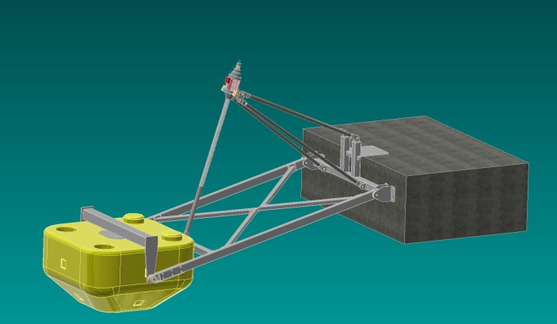
Small scale system – the Svalbard Class
Magnetic gear accelerates slow motions – slow and small waves. Demonstrated live with mini unit. See figure.
The magnetic gear ensures efficient energy production in large scale implementation. Planned unit will generate 1 – 10 kW with a buoy of 1.8 meter diameter.
«Svalbard Class Buoy»

Slide 19
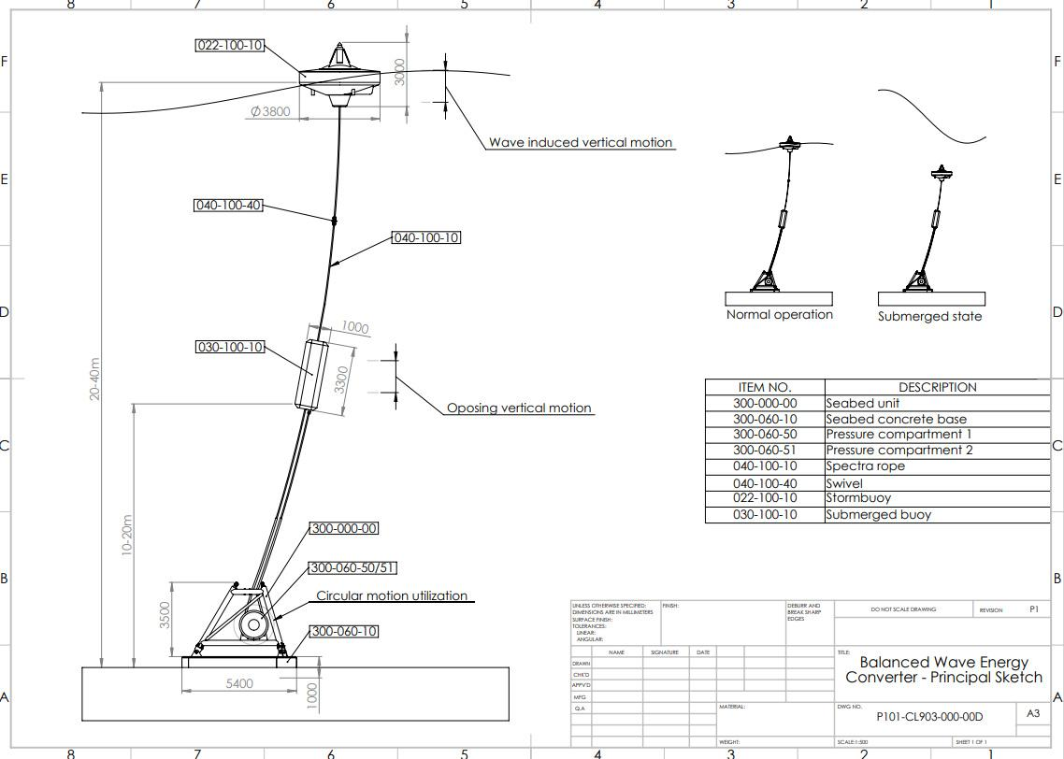
Large scale – the Balanced System with Storm Buoy
Large scale system for up to 50 kW per unit

Slide 20
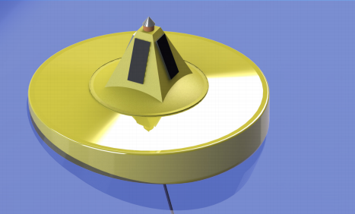
Large scale – the Balanced System with Storm Buoy
Efficient energy production for a wide range of wave amplitudes. Can handle very big waves with high energy content.
The Storm Buoy ensures that the system is secured for extreme weather conditions.

Slide 21
Patents
Objective: to secure the products with patents covering the main functions of the systems.
Current patents for large scale system:
Patent describing an intelligent buoy capable of handling rough weather conditions (by bringing the buoy down to save depth under the surface). («Storm Buoy»)
Patent describing a ”balanced system” capable of generating electricity from waves with varying amplitudes (from very small to very big waves) and automatic handle varying water level (tide water). («The Balanced System»)
Current patent for small scale system
Patent describing electricity generation by linear generators for buoys («Elfarming»)

Slide 22
Economy (example large scale park on Canary Island)
Number of generators: 200 Total investment: 24,0 mill EURO Power per generator: 50 kW
Generation time (average): 5.000 h / y Price electricity (guaranteed): 0,15 EURO/ kWh
Income: 8,0 mill EURO/ y

Slide 23
Potential
We estimate the potential for large scale systems:
Total potential is around 10.000 parks worldwide with 200 generators per park (approx 10 parks per island of interest and the same number on mainland with fossile electricity production today)
During the next 10 year period we estimate a potential of 600 parks.

Slide 24
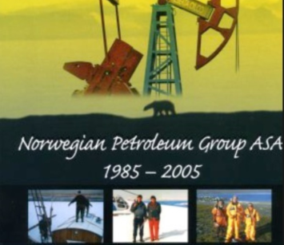
Experience at OCE founders:
Develop companies from start-up to market introduction
Extensive international sales experience
Develop innovations from idea to patent
Manage technical development projects
Notes:
Tov Westby - Oppfinner av «Storm Bøyen»– medgrunnlegger av børsnoterte Mamut ASA i 1994 som ble solgt til Visma ASA for 800 Mill. i 2011.
Asbjørn Skotte – medoppfinner av Ocean Energys patenter og grunnlegger av bla. noterte Norwegian Petroleum ASA som ble solgt for 120 Mill. i 2005.

Slide 25
Ocean Energy
The Waves of the Future

